Slide 1
DATA WRANGLING
 | Review | country | polarity | subjectivity
0 | I made a booking 5 months ago with Airbnb for ... | France | 0.073437 | 0.33125
1 | Absolutely terrible service . My booking was c... | Britain | -0.4 | 0.95
2 | I can't begin to state my hatred for this comp... | Russia | -0.435059 | 0.5
3 | After finding a suitable property, I clicked r... | Demark | 0.077143 | 0.334921
4 | I was a host. Airbnb did not pay me adequately... | Netherland | 0.333333 | 0.333333
5 | I tried to book our first holiday in 7 years t... | Ireland | 0.24 | 0.524444
6 | I have been using Ait BnB for a few years now ... | Poland | 0.097876 | 0.520698
7 | I had a terrible experience with booking with ... | France | 0.214471 | 0.537116
8 | I am working in a new city and was using Airbn... | Ireland | -0.087328 | 0.516322
9 | Infestation of ants in static caravan hire fro... | Poland | -0.091667 | 0.463889
Well structure data : reviews with sentiment and location

Slide 2
DATA WRANGLING
 | polarity | subjectivity | num_review
country
American | -0.011448 | 0.498458 | 91
Australia | -0.017265 | 0.498407 | 97
Britain | -0.001601 | 0.471591 | 104
Canada | 0.016703 | 0.50223 | 80
Demark | -0.037134 | 0.500692 | 91
Finland | 0.024559 | 0.529969 | 89
France | -0.042596 | 0.494112 | 80
Germany | 0.024071 | 0.53876 | 83
Greece | 0.019982 | 0.506677 | 100
India | 0.006656 | 0.480366 | 83
Ireland | -0.026936 | 0.507849 | 82
Isreal | -0.089037 | 0.496271 | 79
Netherland | 0.046984 | 0.453022 | 93
Poland | -0.0163 | 0.527458 | 84
Potugal | -0.008685 | 0.486872 | 77
Russia | 0.008611 | 0.457906 | 103
Spain | -0.014822 | 0.493235 | 84
Group by ‘Country’
Aggregate sentiment score
Counting the number of reviews
By Country

Slide 3
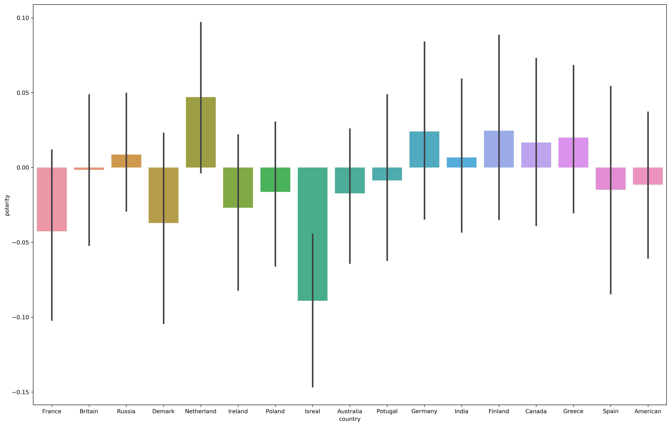
VISUALIZATION
Bar chart

Slide 4
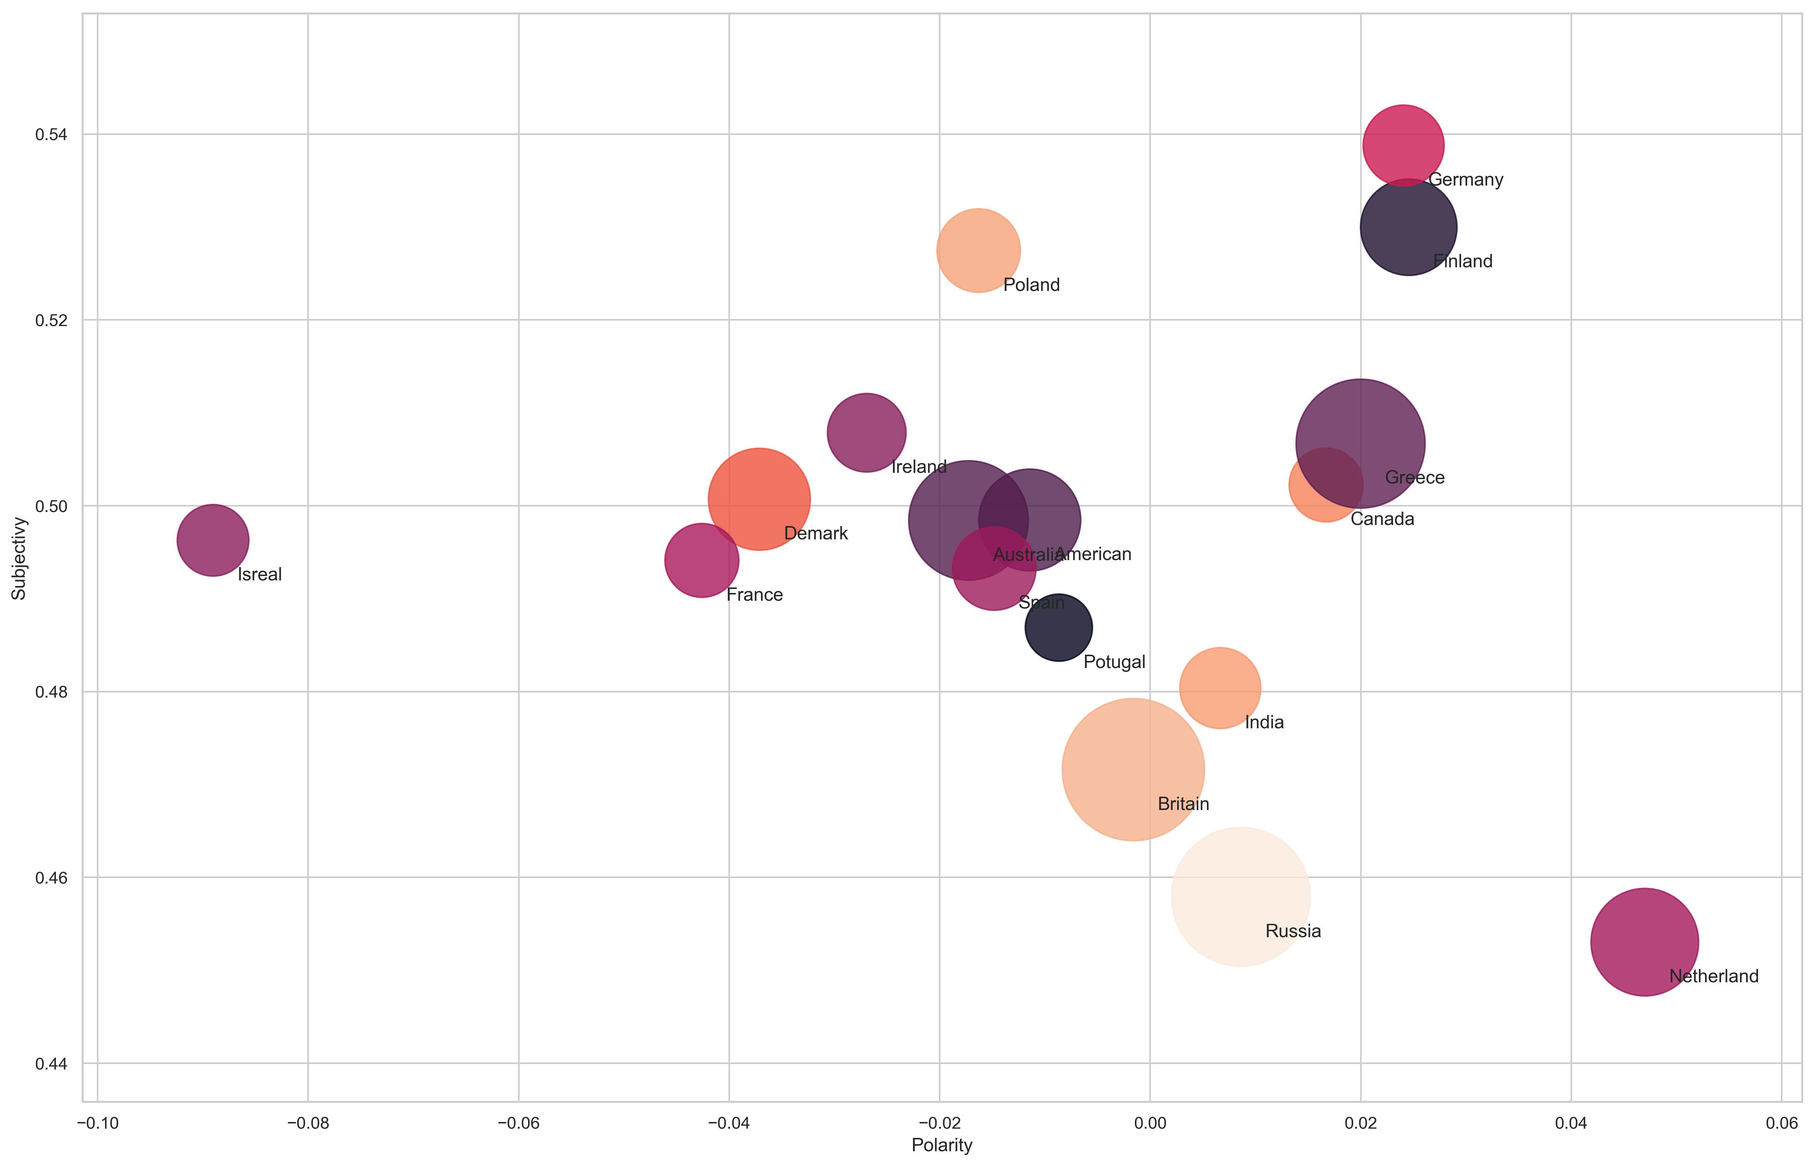
VISUALIZATION 2
Scatter plot

